Slide 1
Optimal Stopping for Batch Bioprocesses: A Stochastic Differential Analysis
Bachelor’s Thesis of Rafif Sulthan Ramadhan
Mechanical Engineering, Specialization Chemical Engineering
Advisor: Dr.-Ing. Eike Cramer
Examiners: Prof. Alexander Mitsos, Ph.D.
Prof. Dr.-Ing. Adel Mhamdi
Aachen, July 28, 2025

Slide 2

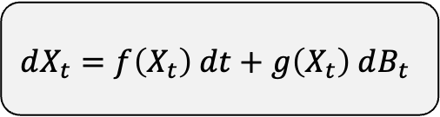
State of the art: Stochastic Chemical Systems
Stochastic Model | Optimal Stopping | Case Study | Results | Conclusions
Increasing attention to the stochastic dynamics in population balance ^{[1]}
Research focus:
Developing a model for a batch bioreactor using SDEs
Decision making on stochastic systems
$$dX_{t}=f\left(X_{t}\right) dt+g\left(X_{t}\right) dB_{t}$$
Stochastic reaction kinetics ^{[2]}
Chemical Master Equation (CME)
Stochastic Simulation Algorithm (SSA)
Reactor modeling under uncertainty
When to act under uncertainty?
Optimal stopping problem
Stochastic Differential Equation (SDE) ^{[3]}
Controller Design ^{[4]}
[1] Ramkrishna and Singh (2014)
[2] Gillespie (2007)
[3] Baratti et al. (2021)
[4] Alvarez and Baratti (2023)

Slide 3

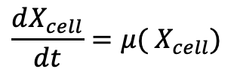
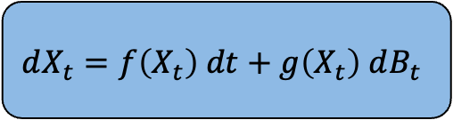
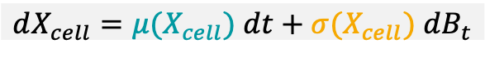
Stochastic Batch Bioreactor
Stochastic Model | Optimal Stopping | Case Study | Results | Conclusions
$$\frac{dX_{cell}}{dt}=μ( X_{cell})$$
+
Stochastic Differential Equations (SDEs) ^{[3]}
$$dX_{t}=f\left(X_{t}\right) dt+g\left(X_{t}\right) dB_{t}$$
Brownian motion
Monod kinetics
Drift term: reaction kinetics
Diffusion term: noise
Biomass
Cell 1
Cell n
External noise ^{[1,2]}
$$dX_{cell}=μ(X_{cell}) dt+σ(X_{cell}) dB_{t}$$
Biological noise ^{[1]}
[1] Pischel, Sundmacher and Flassig (2017)
[2] Baratti et al. (2018)
[3] Thygesen (2023)

Slide 4
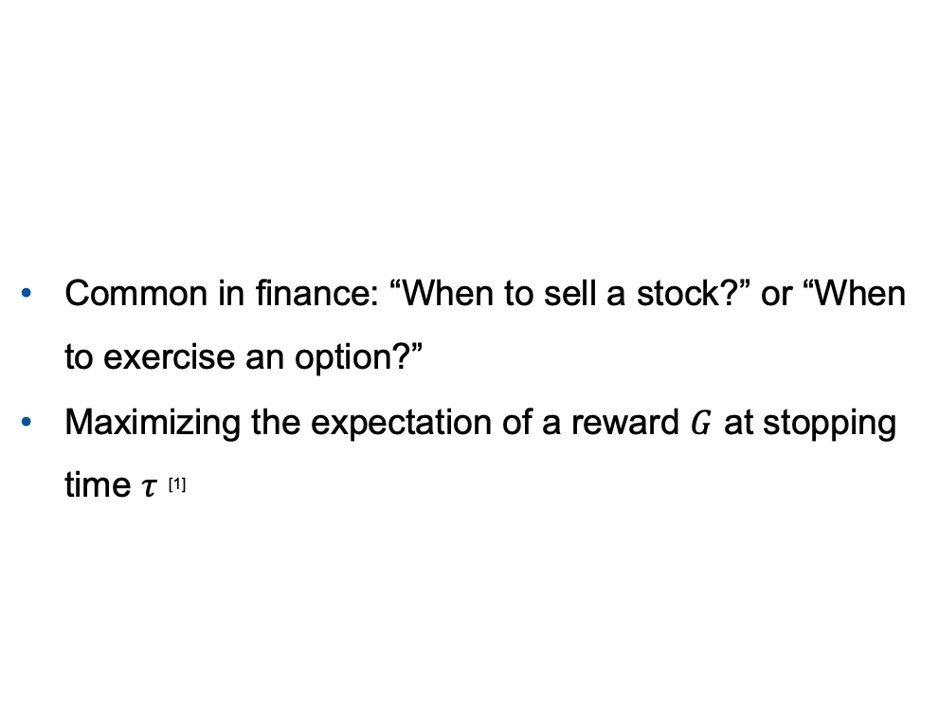
Optimal stopping Problem
Stochastic Model | Optimal Stopping | Case Study | Results | Conclusions
Common in finance: “When to sell a stock?” or “When to exercise an option?”
Maximizing the expectation of a reward $G$ at stopping time $τ$ ^{[1]}
When to act under uncertainty?
Optimal stopping problem
Can we use tools from finance for engineering problems?
[1] Shiryaev and Peskir (2006)

Slide 5
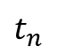
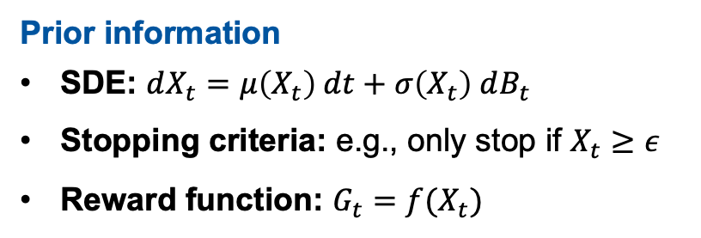
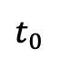
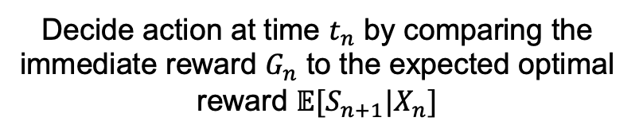
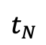
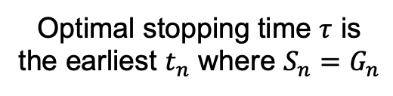
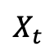
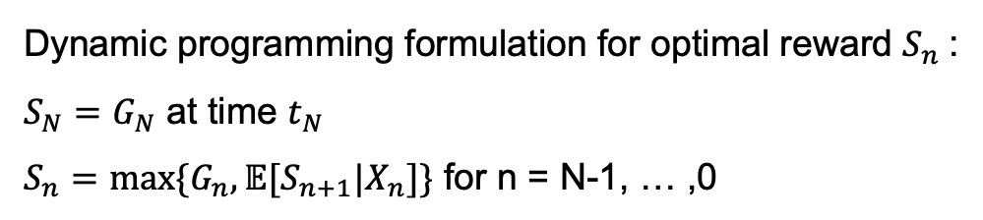
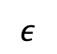
Longstaff-Schwartz Algorithm
Stochastic Model | Optimal Stopping | Case Study | Results | Conclusions
Initially used for the valuation of financial derivatives
$$X_{t}$$
Prior information
SDE: $dX_{t}=μ\left(X_{t}\right) dt+σ\left(X_{t}\right) dB_{t}$
Stopping criteria: e.g., only stop if $X_{t}≥ε$
Reward function: $G_{t}=f(X_{t})$
$$ε$$
Decide action at time $t_{n}$ by comparing the immediate reward $G_{n}$ to the expected optimal reward $𝔼[S_{n+1}|X_{n}]$
.
$$t_{0}$$
$$t_{n}$$
$$t_{N}$$
Dynamic programming formulation for optimal reward $S_{n}$:
$S_{N}=G_{N}$ at time $t_{N}$
$S_{n}=max⁡\{G_{n},𝔼[S_{n+1}|X_{n}]\}$ for n = N-1, … ,0
Optimal stopping time $τ$ is the earliest $t_{n}$ where $S_{n}=G_{n}$

Slide 6
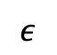
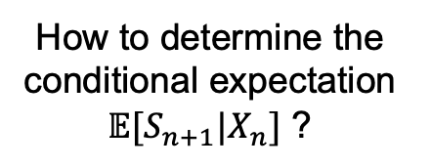
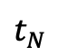
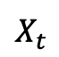
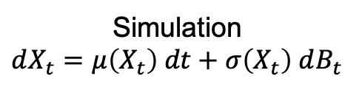
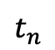
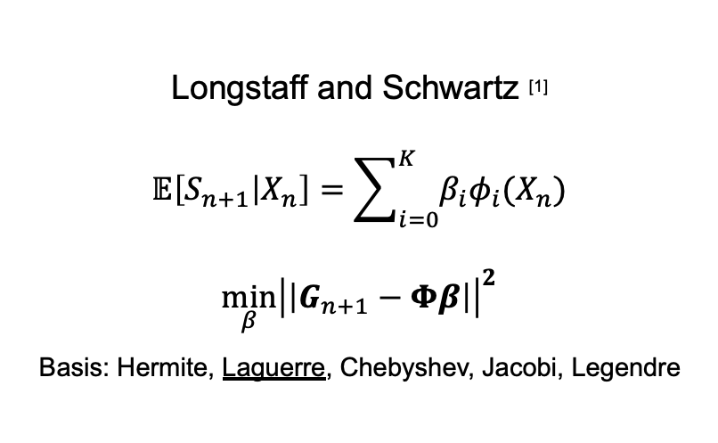
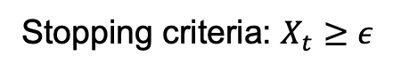
Longstaff-Schwartz Algorithm
Stochastic Model | Optimal Stopping | Case Study | Results | Conclusions
$$X_{t}$$
How to determine the conditional expectation $𝔼[S_{n+1}|X_{n}]$ ?
Simulation $$dX_{t}=μ\left(X_{t}\right) dt+σ\left(X_{t}\right) dB_{t}$$
Longstaff and Schwartz ^{[1]} $$𝔼\left[S_{n+1} | X_{n}\right]=\sum_{i=0}^{K}{β_{i}φ_{i}(X_{n})} \\ \min_{β}{{\left|\left|G_{n+1}−Φβ\right|\right|}^{2}}$$
Basis: Hermite, Laguerre, Chebyshev, Jacobi, Legendre
$$ε$$
Stopping criteria: $X_{t}≥ε$
$$t_{n}$$
$$t_{N}$$
Only use valid scenarios (Stopping criteria is satisfied)
Improving accuracy and efficiency ^{[1]}
[1] Longstaff and Schwartz (2001)

Slide 7
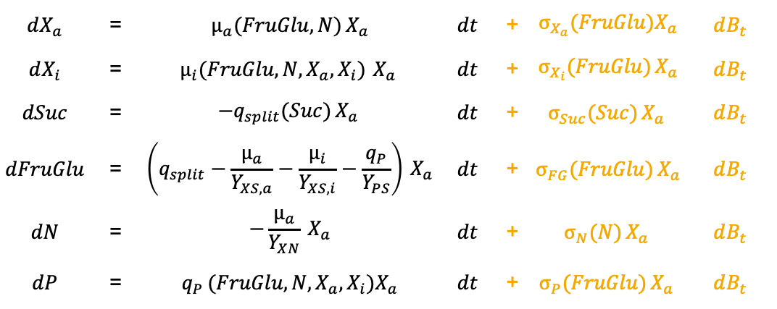
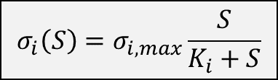
Case Study: Malic Acid Batch Production (AVT.BioVT)
Stochastic Model | Optimal Stopping | Case Study | Results | Conclusions
Biomass: Ustilago trichophora
Secondary substrate limitation from nitrogen
Mass balances ^{[1]}
Fructose
Glucose
$$dX_{a}$$ | = | $$μ_{a}(FruGlu,N) X_{a}$$ | $$dt$$ | + | $$σ_{X_{a}}(FruGlu)X_{a}$$ | $$dB_{t}$$
$$dX_{i}$$ | = | $$μ_{i}(FruGlu,N, X_{a},X_{i}) X_{a}$$ | $$dt$$ | + | $$σ_{X_{i}}(FruGlu) X_{a}$$ | $$dB_{t}$$
$$dSuc$$ | = | $$−q_{split}(Suc) X_{a}$$ | $$dt$$ | + | $$σ_{Suc}(Suc) X_{a}$$ | $$dB_{t}$$
$$dFruGlu$$ | = | $$\left(q_{split}−\frac{μ_{a}}{Y_{XS,a}}−\frac{μ_{i}}{Y_{XS,i}}−\frac{q_{P}}{Y_{PS}}\right) X_{a}$$ | $$dt$$ | + | $$σ_{FG}(FruGlu) X_{a}$$ | $$dB_{t}$$
$$dN$$ | = | $$−\frac{μ_{a}}{Y_{XN}} X_{a}$$ | $$dt$$ | + | $$σ_{N}(N) X_{a}$$ | $$dB_{t}$$
$$dP$$ | = | $$q_{P} (FruGlu,N, X_{a},X_{i})X_{a}$$ | $$dt$$ | + | $$σ_{P}(FruGlu) X_{a}$$ | $$dB_{t}$$
Sucrose
Ammonia
Biomass
Biomass
$$σ_{i}\left(S\right)=σ_{i,max}\frac{S}{K_{i}+S}$$
Malic Acid
[1] Maschmeier, Master Thesis (2024)

Slide 8
Case Study: Malic Acid Batch Production
Stochastic Model | Optimal Stopping | Case Study | Results | Conclusions

Slide 9
Case Study: Malic Acid Batch Production
Stochastic Model | Optimal Stopping | Case Study | Results | Conclusions

Slide 10
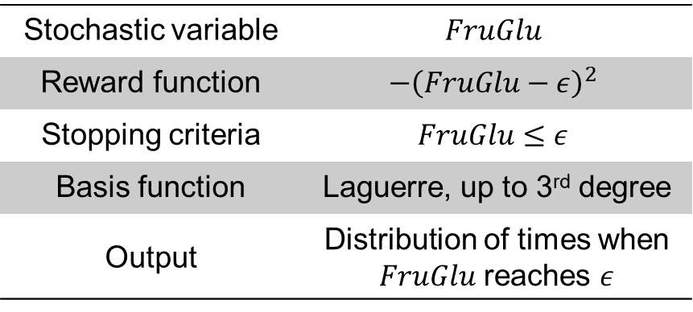
Optimal Stopping Problem
Stochastic Model | Optimal Stopping | Case Study | Results | Conclusions
When is the substrate almost depleted?
Longstaff-Schwartz Information
Stochastic variable | $$FruGlu$$
Reward function | $$−{\left(FruGlu−ε\right)}^{2}$$
Stopping criteria | $$FruGlu≤ε$$
Basis function | Laguerre, up to 3rd degree
Output | Distribution of times when $FruGlu$ reaches $ε$
5% of initial substrate
Can be compared to the actual time distribution directly obtained from the simulation

Slide 11
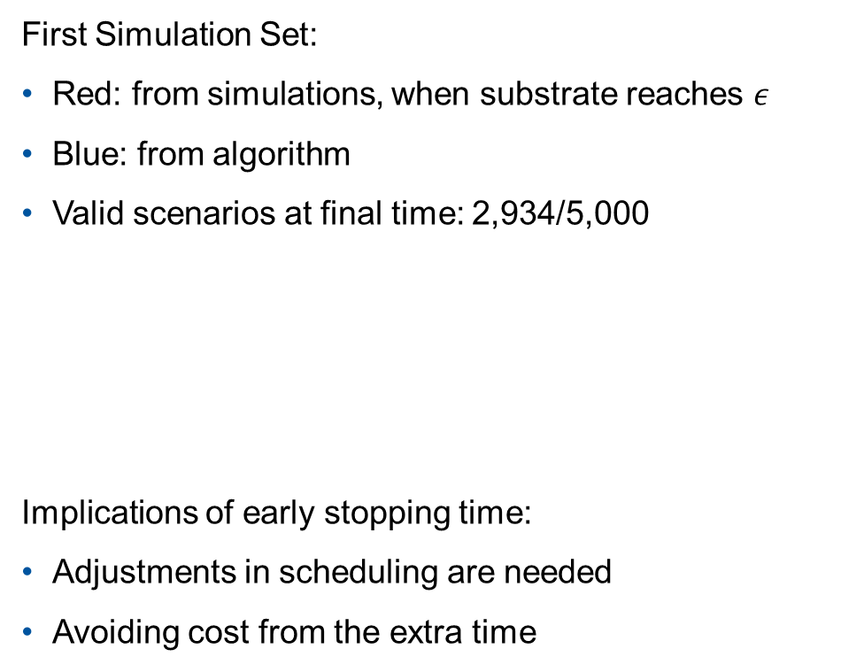
Results
Stochastic Model | Optimal Stopping | Case Study | Results | Conclusions
First Simulation Set:
Red: from simulations, when substrate reaches $ε$
Blue: from algorithm
Valid scenarios at final time: 2,934/5,000
Implications of early stopping time:
Adjustments in scheduling are needed
Avoiding cost from the extra time
Deterministic hit time | 35.7h
Average optimal stop time | 32.9h
Average stochastic hit time | 32.9h
Max. CDF difference | 0.14%
Two-sided p-value | 1

Slide 12

Results
Stochastic Model | Optimal Stopping | Case Study | Results | Conclusions
Second Simulation Set:
Valid scenarios at final time: 3,006/5,000
Minimal difference in the average of the optimal stopping time
Deterministic hit time | 35.7h
Average optimal stop time Set 1 | 32.9h
Average optimal stop time Set 2 | 33h
Robust–considering nonlinear, stochastic dynamics

Slide 13



Conclusions
Stochastic Model | Optimal Stopping | Case Study | Results | Conclusions
SDE model for a batch biochemical process
Outlook
Validation of the noise model
Optimal stopping problem based on the SDE model
Other types of reactors
Stopping rule based on process values
Applied the Longstaff-Schwartz algorithm to an engineering problem

Slide 15
Malic Acid Simulation With BioVT Parameters ^{[1]}
Stochastic Model | Optimal Stopping | Case Study | Results | Conclusions
[1] Maschmeier, Master Thesis (2024)

Slide 16
Malic Acid Simulation With New Parameters
Stochastic Model | Optimal Stopping | Case Study | Results | Conclusions

Slide 17
Stiffness Ratios
Stochastic Model | Optimal Stopping | Case Study | Results | Conclusions

Slide 18
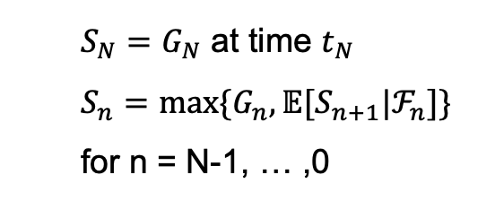
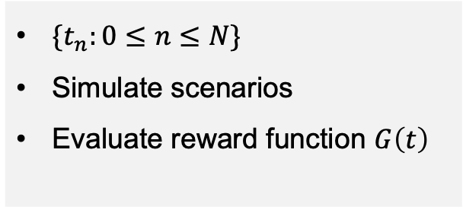
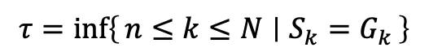
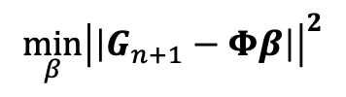
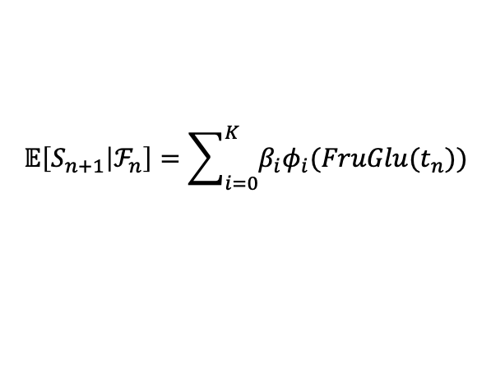
Longstaff-Schwartz Algorithm
Stochastic Model | Optimal Stopping | Case Study | Results | Conclusions
Simulation
Backward Induction
Regression
$\{t_{n}:0≤n≤N\}$
Simulate scenarios
Evaluate reward function $G\left(t\right)$
Dynamic programming ^{[3]}
Longstaff-Schwartz ^{[4]}
$S_{N}=G_{N}$ at time $t_{N}$
$S_{n}=max⁡\{G_{n},𝔼[S_{n+1}|ℱ_{n}]\}$ for n = N-1, … ,0
$$𝔼\left[S_{n+1} | ℱ_{n}\right]=\sum_{i=0}^{K}{β_{i}φ_{i}(FruGlu(t_{n}))}$$
$$\min_{β}{{\left|\left|G_{n+1}−Φβ\right|\right|}^{2}}$$
.
No restriction on basis function
Only relevant scenarios (in-the-money)
Fewer basis needed
Optimal time
For each scenario
$$τ=inf\left\{n≤k≤N ∣ S_{k}=G_{k}\right\}$$
[3] Glasserman (2003)
[4] Longstaff and Schwartz (2001)

Slide 19
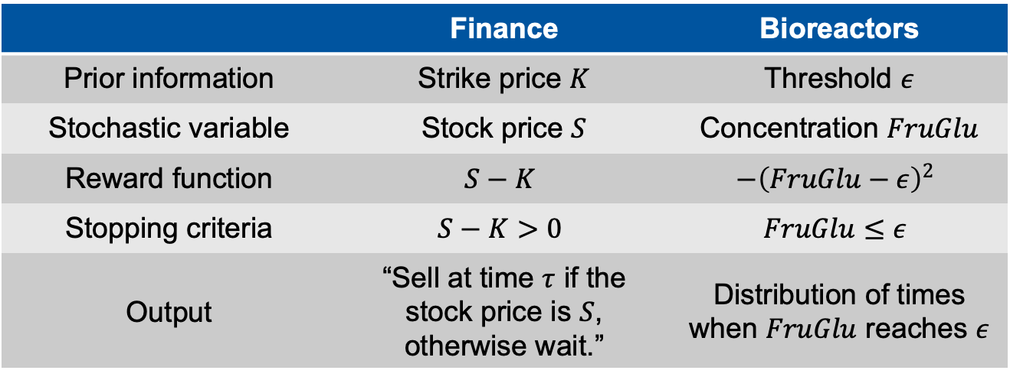
Optimal Stopping: From Finance to Bioreactors
Stochastic Model | Optimal Stopping | Case Study | Results | Conclusions
 | Finance | Bioreactors
Prior information | Strike price $K$ | Threshold $ε$
Stochastic variable | Stock price $S$ | Concentration $FruGlu$
Reward function | $$S−K$$ | $$−{\left(FruGlu−ε\right)}^{2}$$
Stopping criteria | $$S−K>0$$ | $$FruGlu≤ε$$
Output | “Sell at time $τ$ if the stock price is $S$, otherwise wait.” | Distribution of times when $FruGlu$ reaches $ε$
Can be compared to the actual time distribution directly obtained from the simulation

Slide 20
Results
Stochastic Model | Optimal Stopping | Case Study | Results | Conclusions
Second Ensemble Set:
Valid scenarios at final time: 3,006/5,000
Regression of the expected optimal reward uses all scenarios at every time step
Deterministic hit time | 35.7h
Average optimal stop time | 33h
Average stochastic hit time | 32.6h

Slide 21
Results
Stochastic Model | Optimal Stopping | Case Study | Results | Conclusions
Second Ensemble Set:
Valid scenarios at final time: 3,006/5,000
Regression of the expected optimal reward uses all scenarios at every time step
KS Test confirms the statistical difference of the distributions
Deterministic hit time | 35.7h
Average optimal stop time | 33h
Average stochastic hit time | 32.6h
Max. difference | 4.8%
Two-sided p-value | 0.002
Accurate identification of hitting times through LSMC possible if only valid scenarios are used

Slide 22
Results
Stochastic Model | Optimal Stopping | Case Study | Results | Conclusions
First Ensemble Set: 2,934/5,000 scenarios
Similarity of the distribution is further confirmed through KS test
Deterministic hit time | 35.7h
Average optimal stop time | 32.9h
Average stochastic hit time | 32.9h
Max. difference | 0.14%
Two-sided p-value | 1

